Slide 1
Stevensville School District Bond Election May 8, 2018
Stevensville Public Schools

Slide 2
Bond Summary
2017 Long-range master plan developed for Stevensville School District by MMW Architects using a consensus process with teachers, students, parents, community members and Board members
Stevensville School Board identified $16.6 million in immediate needs based on input from school community (teachers, students, parents, and community members)
  Student safety
  Deferred maintenance
  Renovations to buildings & grounds
  Sanitation
  Access and parking
Two bond issues will be voted on May 8, 2018 – Mail Ballot
  Stevensville – High School and Elementary Bonds
  Lone Rock – High School Bond Only

Slide 3
Two Bonds are Requested
Elementary Bond
Principal $6,876,000
Approx. Interest
$2,276,000
High School Bond
Principal $9,745,000
Approx. Interest $3,226,000

Slide 4
Elementary Bond
Classrooms, Safety/Security, Deferred Maintenance
Safety - new entry and administration area. The entry vestibule is two-sided, with a new main entry on the south side of the building and bus drop off entry on the north side of the building.
Energy Savings/Cost Efficiency:
  Replace Heating Controls
  LED lighting,
  Dual pane windows,
  New fans/heating units in classrooms and common areas
Four new classrooms connecting K-3 to Elementary Gym for safety purposes.
Renovate restrooms
Remodeled special education area /other classroom remodels to accommodate a growing demand and handicap accessibility throughout the building.

Slide 5
Elementary Continued
Exterior windows/building deterioration
Drainage around the building exterior
Remodel gym - the 4-8 students to have a separate entrance and exit
Relocating Phillips Street/parking on the south side to provide a safer transition for parent drop off and access to the playground area.
Deferred maintenance as noted in the 2008 Montana Legislative Study
Renovate of the building will require updates to the facility to align with current fire, safety, and accessibility standards.

Slide 6

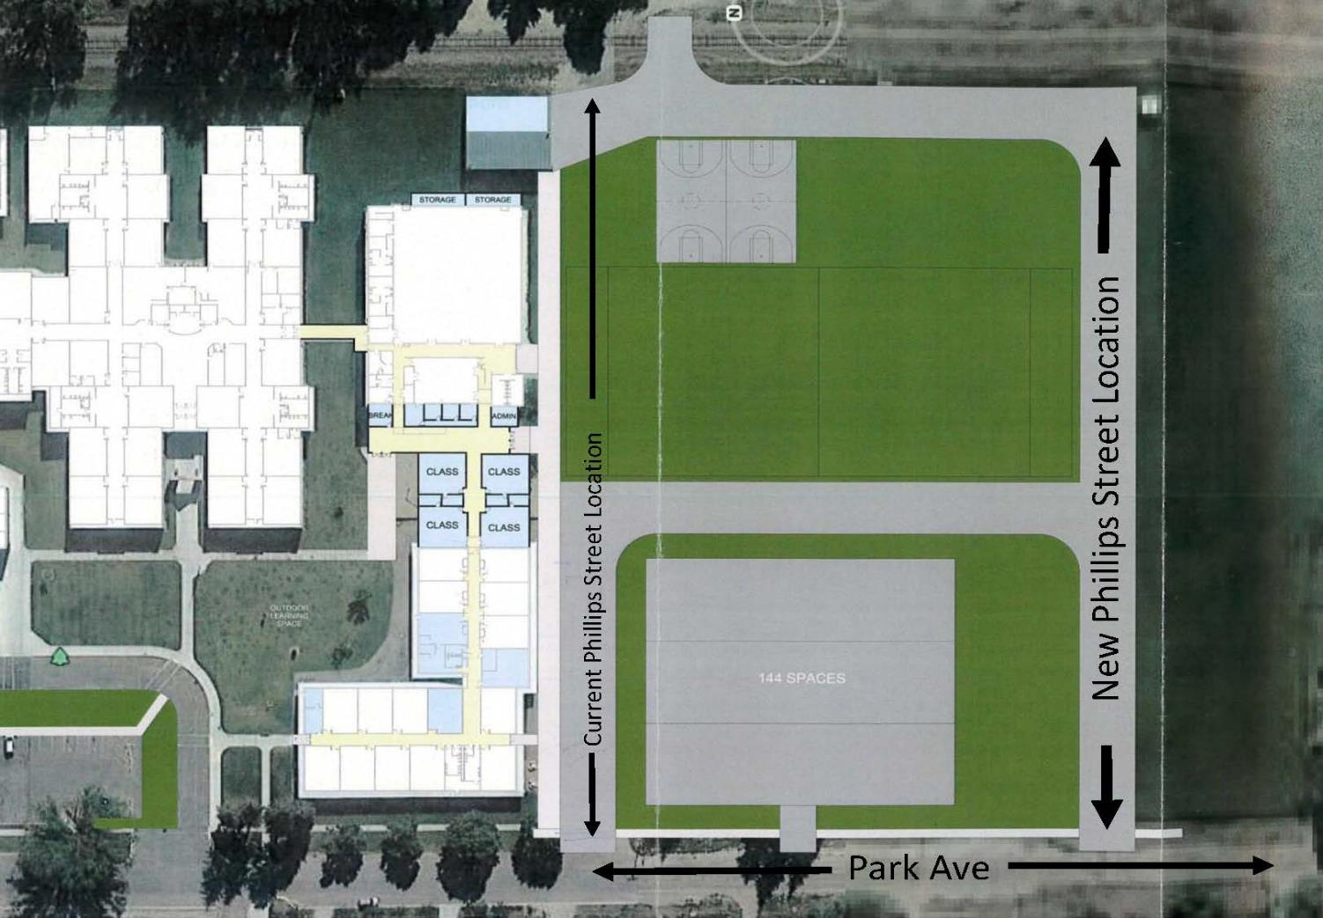
Elementary Site Plan
Elementary Site Plan

Slide 7
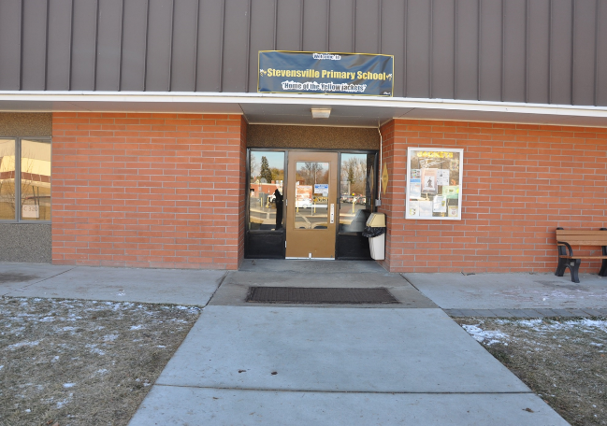
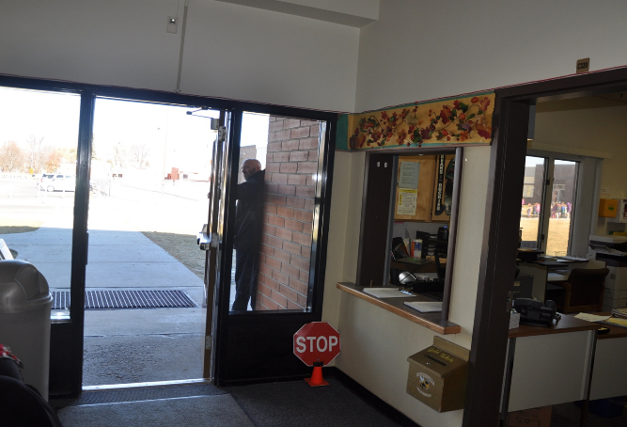
Elementary School Entrance

Slide 8
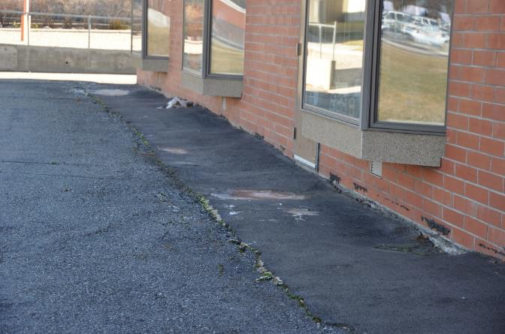
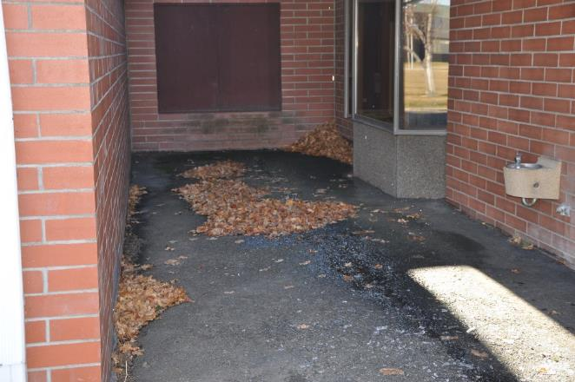
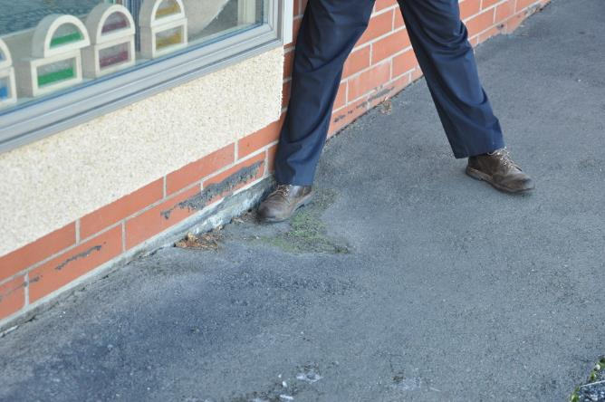
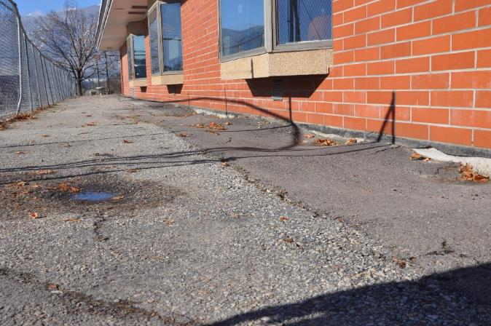
Elementary School Drainage

Slide 9
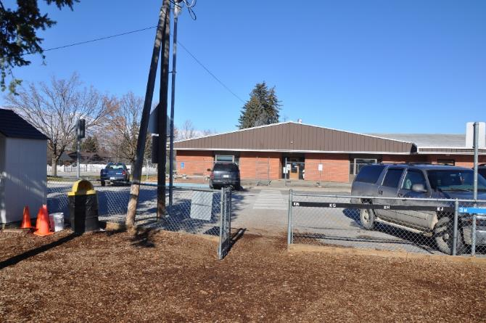
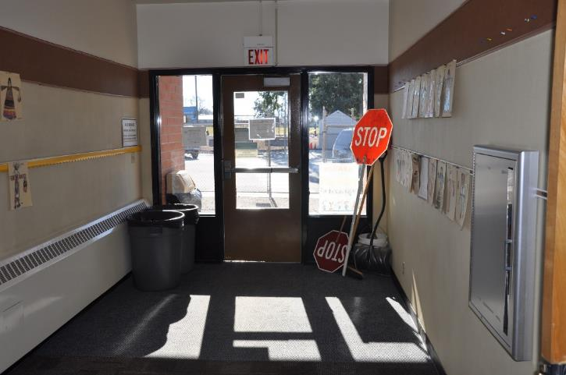
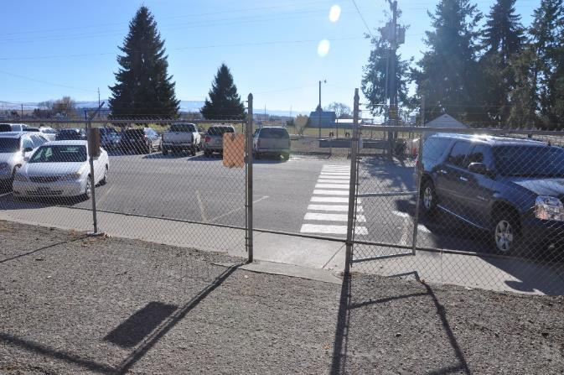
Elementary School Playground Access

Slide 10
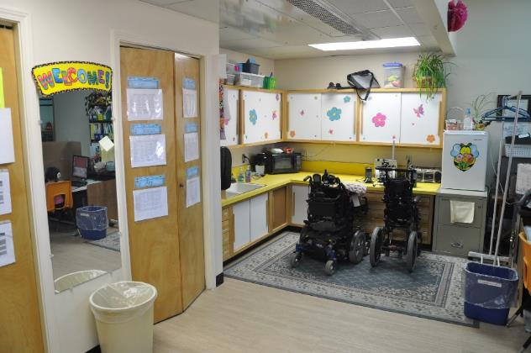
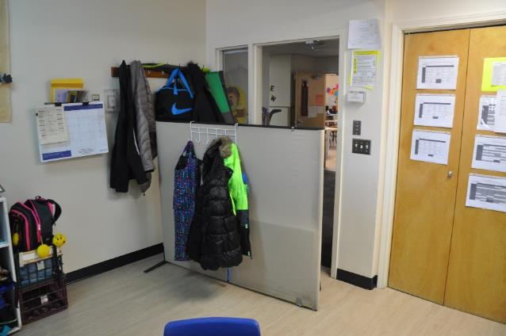
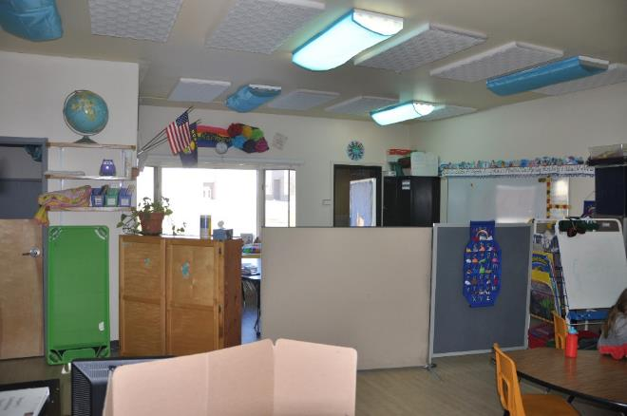
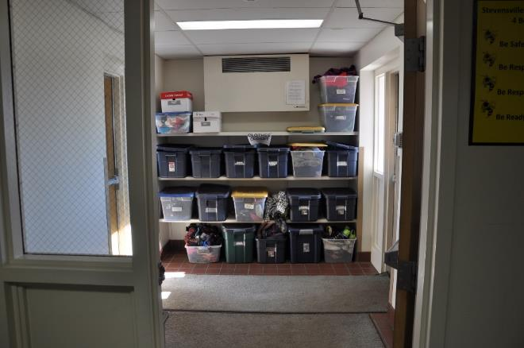
Special Education and Storage

Slide 11
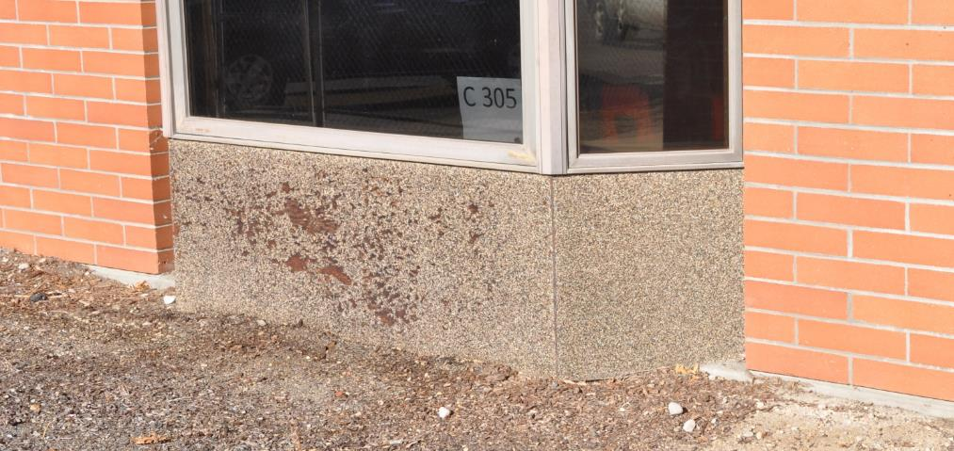
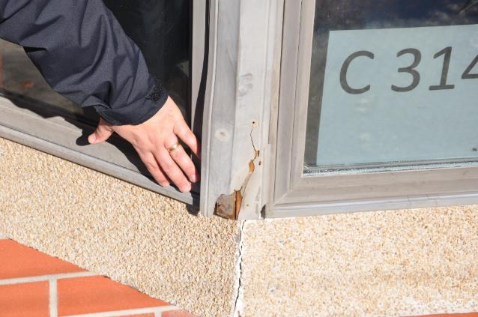
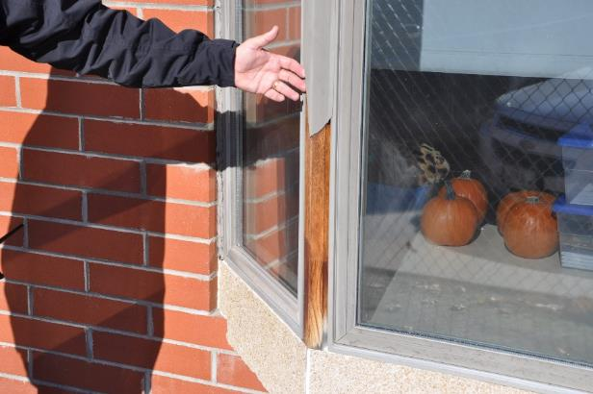
Elementary School Windows

Slide 12
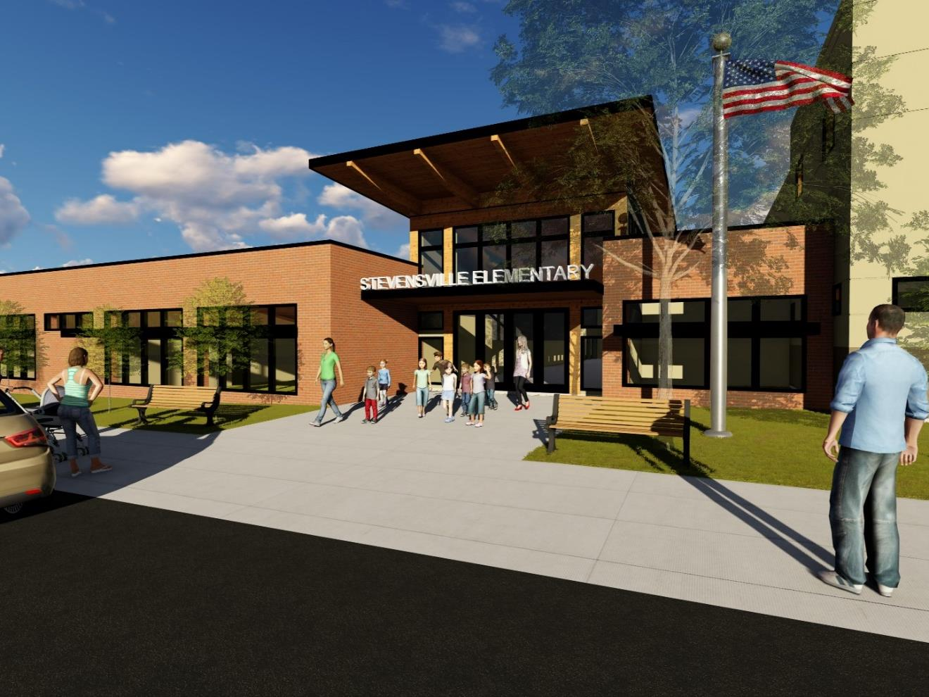
Elementary School from South (Looking North)

Slide 13
High School Bond
Classrooms, Commons, Safety/Security, Extensive Deferred Maintenance
Student Safety - The new east side entrance will provide a more secure and safe entry with over­sight by the administration. This configuration also reduces the main entries for the building.
Energy Savings/Cost Efficiency:
  Replace 1960 boiler,
  LED lighting,
  Dual pane windows,
  New fans/heating units in classrooms and common areas
Parking -changing the entry to the east side of the building
A new hallway will continue around the south side of the building to provide access, connections and improve flow. This single new entry will replace two existing entries.
Replacement of deteriorating asbestos soffit and fascia material on the exterior of the building

Slide 14
High School Continued
Renovate restroom facilities to accommodate handicap accessibility and provide working fixtures
Renovate the library utilizing the current entrance/administration area as student common instructional space with openings to the west to take advantage of the natural light and mountain views
  Modern lighting to improve dark halls
  Natural lighting where possible
  More inviting environment for students
Move PE and practice field to replace existing field eliminated by the parking area
Renovate science classrooms will be to reflect current instructional standards

Slide 15
High School Continued
Renovate locker rooms in Main Gym
  Add appropriate number of toilet fixtures (currently only 2 toilet fixtures)
Current courtyard will be covered and incorporated into the school for flexible classroom space
Deferred maintenance as noted in 2008 Montana Legislative Study
Renovate of the building will require updates to the facility to align with current fire, safety, and accessibility standards

Slide 16
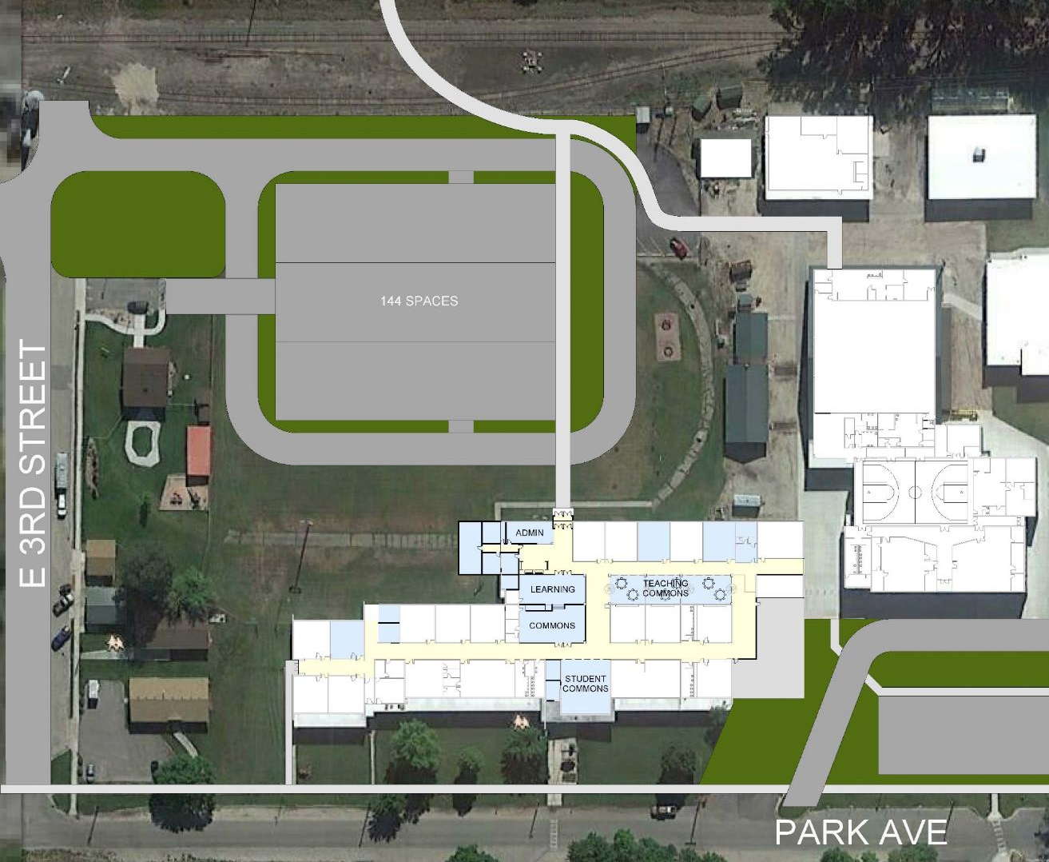

High School Site Plan

Slide 17
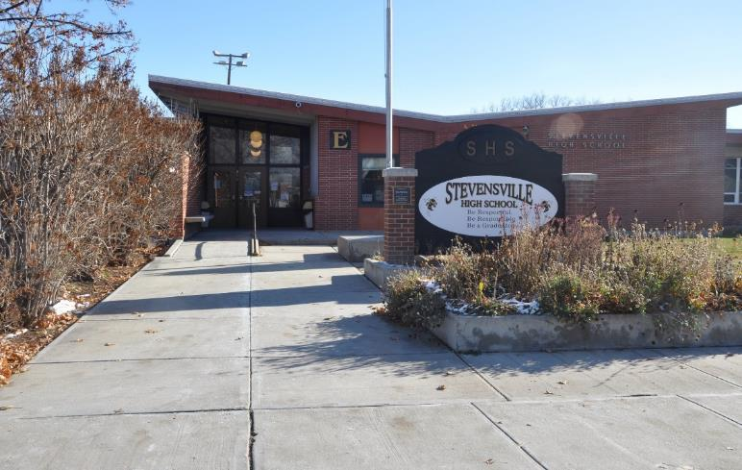
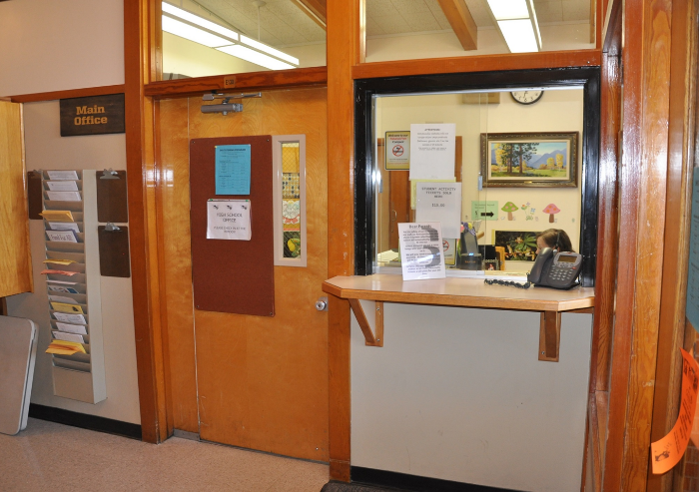
High School Entrance

Slide 18
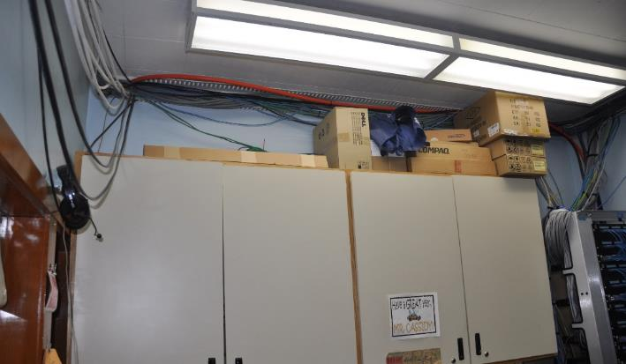
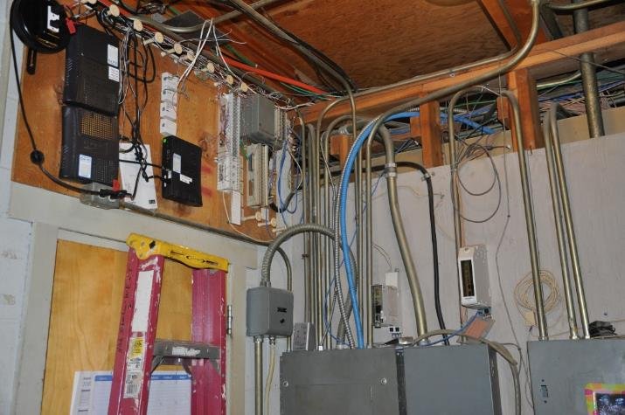
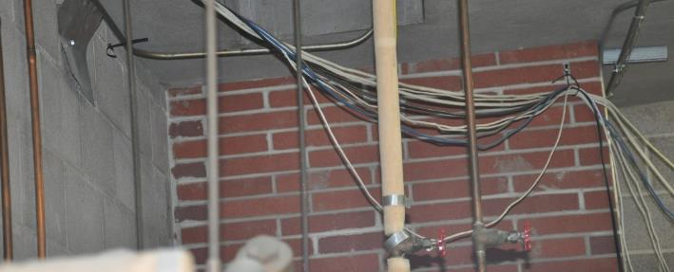
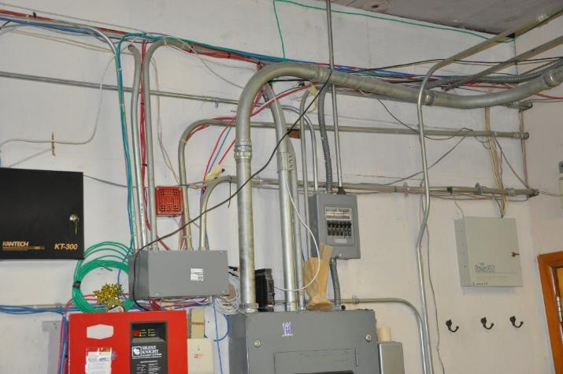
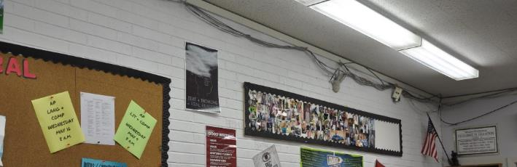
High School Wiring

Slide 19
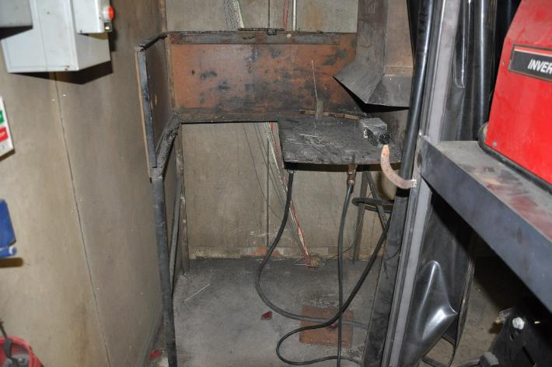
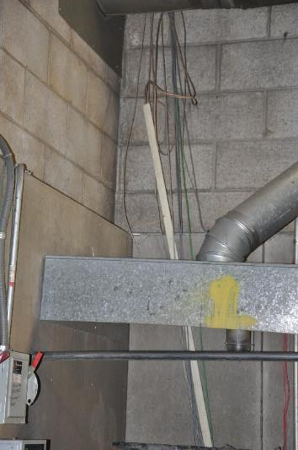
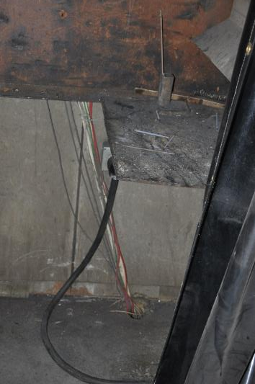
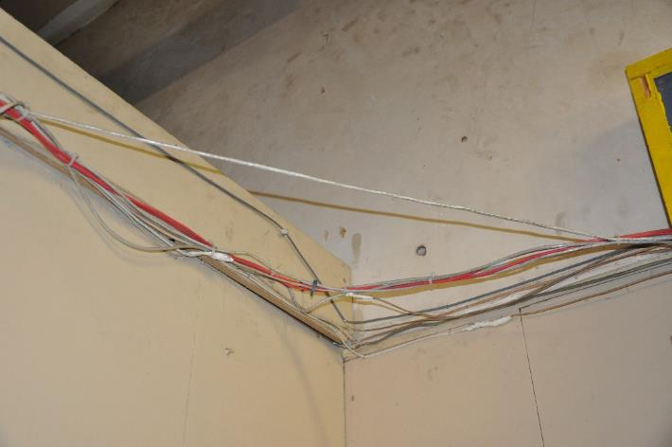
Agriculture Building

Slide 20
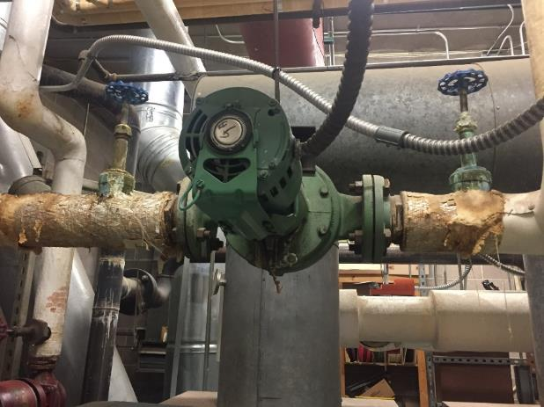
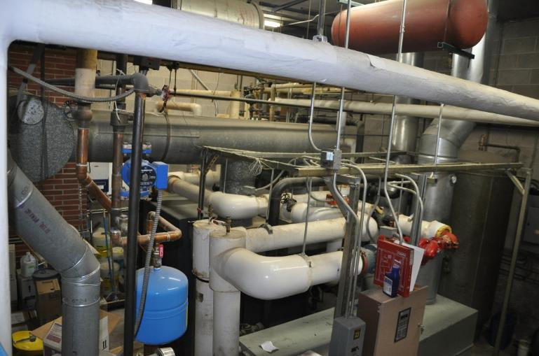
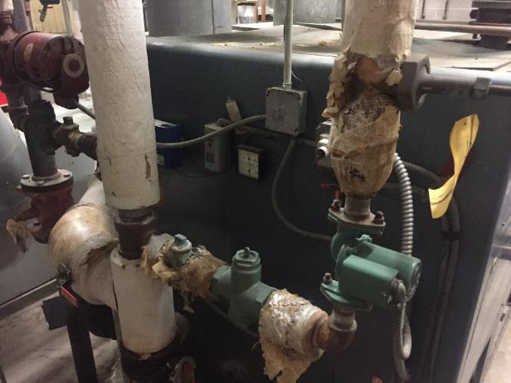
High School Boiler

Slide 21
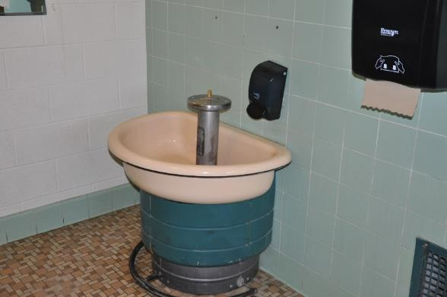
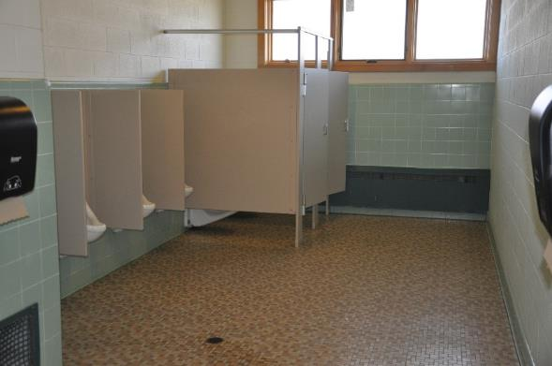
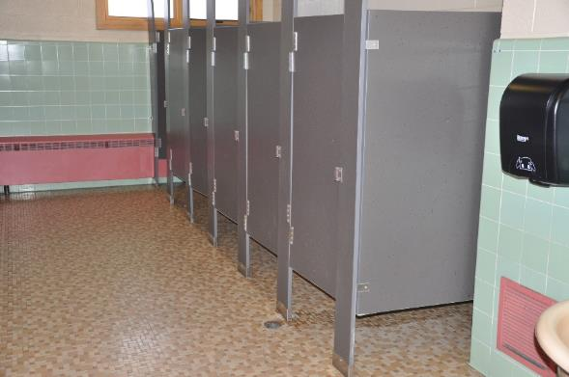
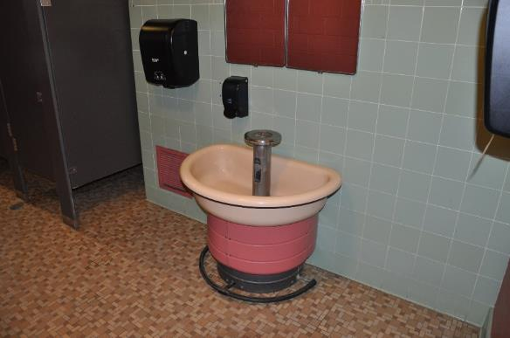
High School Restrooms

Slide 22
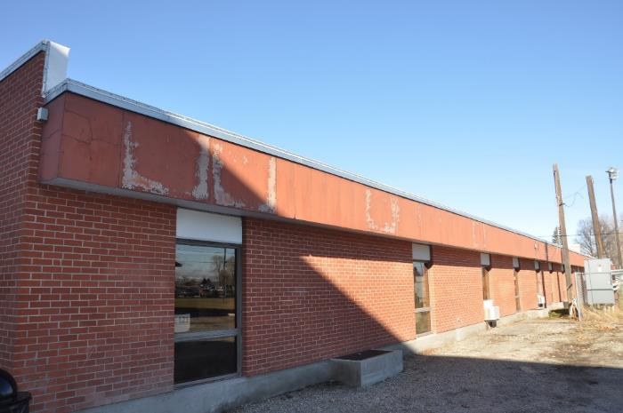
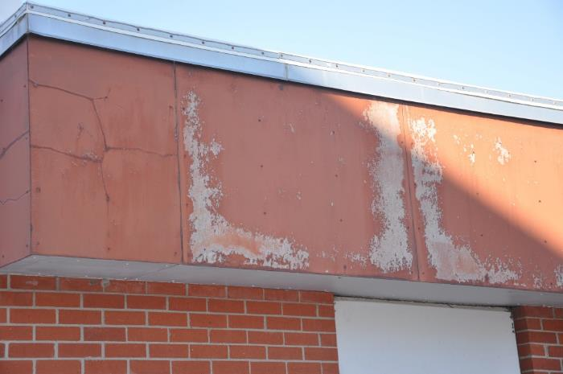
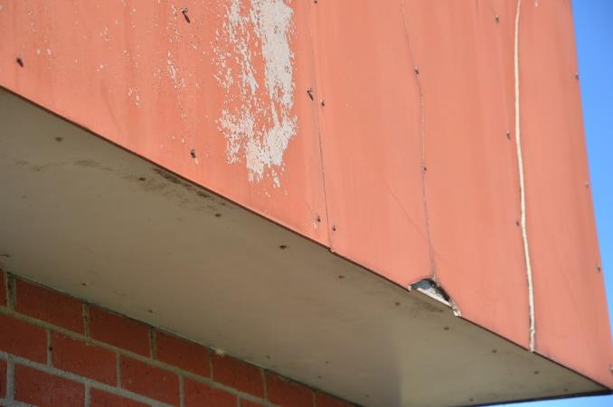
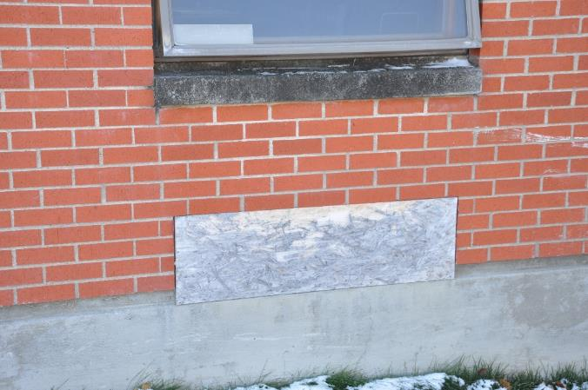
High School

Slide 23
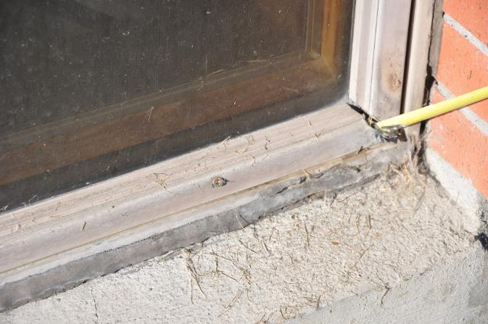
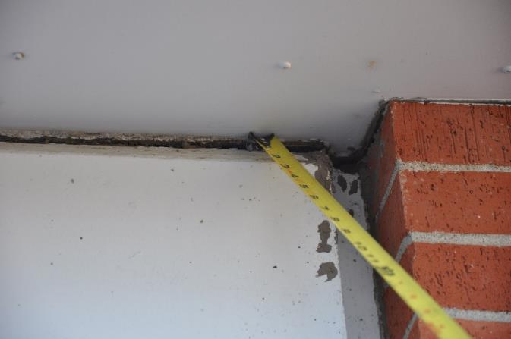
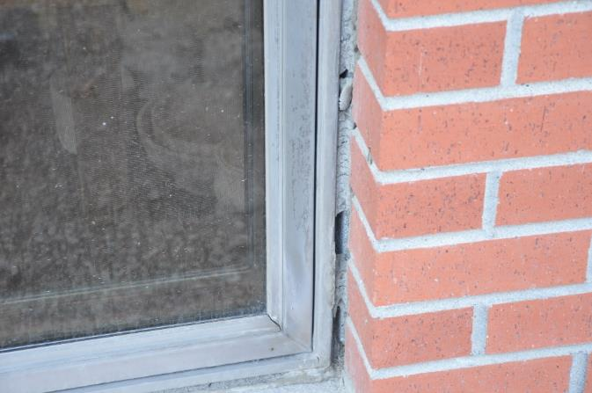
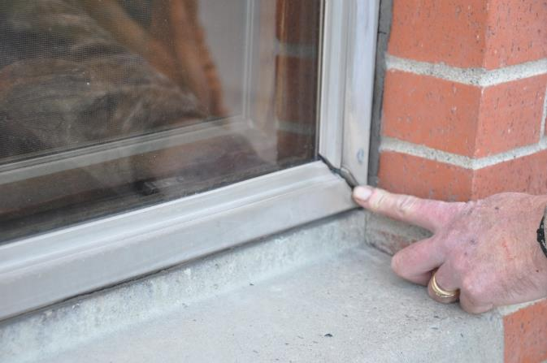
High School Windows

Slide 24
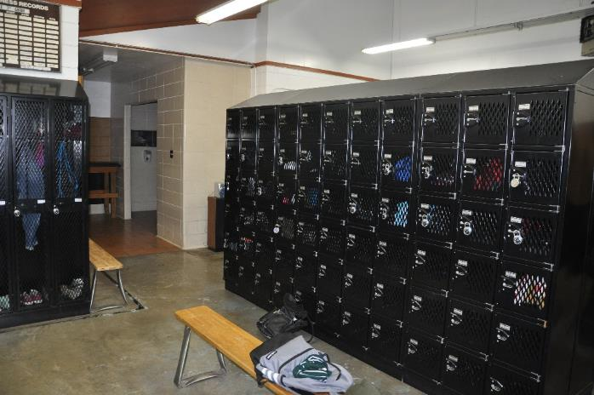
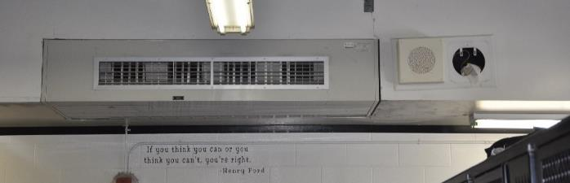
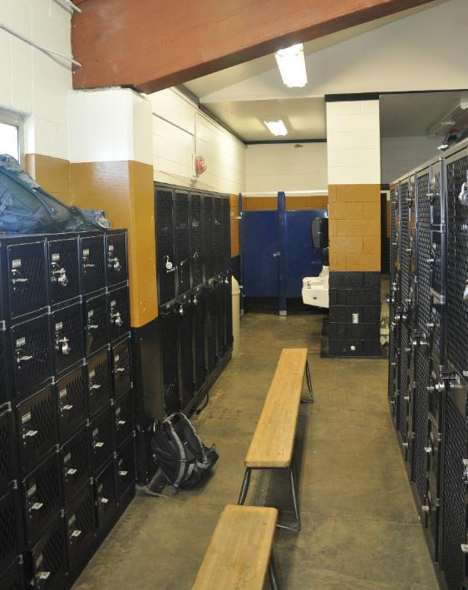
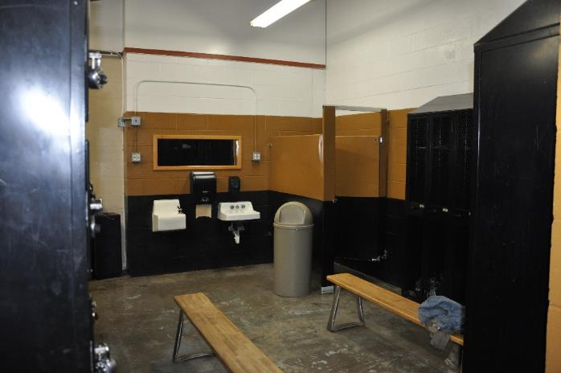
Locker Rooms

Slide 25
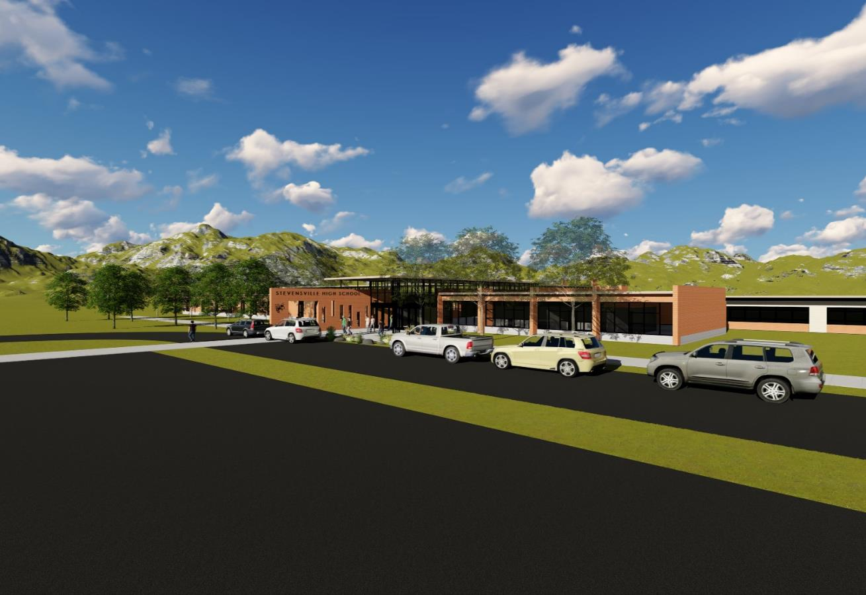
High School from Northeast (Looking Southwest)

Slide 26

High School from Southwest (Looking Northeast)

Slide 27
Shared Bond Costs-Elementary/High School
Bus Barn and Maintenance
  New bus barn and lot
  Renovation of the bus barn to accommodate maintenance

Slide 28
Concessions, Restrooms, Lockers, and Storage
Wet concessions area and public restrooms (No Portable Toilets).
The changing/shelter rooms will include home and visitor changing rooms and space required for officials.
The storage space will be used for sports equipment that we place in temporary storage (shipping containers).
Path to the facility from the school grounds/parking area and a new bridge over the ditch.

Slide 29
Grandstands and Tennis Courts - Deferred Maintenance
New grandstands. The current grandstands are structurally unsound per engineering report.
Refinishing the tennis courts that are need of immediate repair (Used by both school and community).

Slide 30
New Track
400 meter, all-weather track and reinstall football field which will be torn up due to required track drainage. The current track is dirt/cinder and the length is 440 yards rather than the required 400 meters.
Reinstallation of the natural grass football field affected by track installation (Hopefully salvaged turf).

Slide 31

Maintenance Building

Slide 32



Tennis Courts

Slide 33



Track

Slide 34



Grandstand

Slide 35
Bond Summaries
Elementary School 20 Year Bond
High School 20 Year Bond
$9,152,000
Cost Per $100,000 Market Value
$3.85/MO
$46.26/YR
Cost Per $200,000 Market Value
$7.70/MO
$92.51/YR
$12,971,000
Cost Per $100,000 Market Value
$4.08/MO
$49.07/YR
Cost Per $200,000 Market Value
$8.17/MO
$98.14/YR
These estimates are based on property MARKET VALUE as determined by Ravalli County.

Slide 36
State of Montana Deferred Maintenance Survey
(2008)
v
v
v
Compounding Problem Example at 3% Inflation
High School Windows
19 Pages of Deficiencies
Estimated Remaining Cost: $1,320,716
(as of 2008)

Slide 37

More Information?
https://www.stevensvilleschools.org/2018-school-bond/

Slide 38
Back-up Slides

Slide 39

Master Plan

Slide 40

Master Plan (Elementary School)

Slide 41

Master Plan (High School)

Slide 42
Elementary Renovation Costs

Slide 43
High School Renovation Costs

Slide 44
Shared Costs

